Slide 1
SST Importance Sampling
Ideas and Toy Problems
Haden Smith, PE

Slide 2
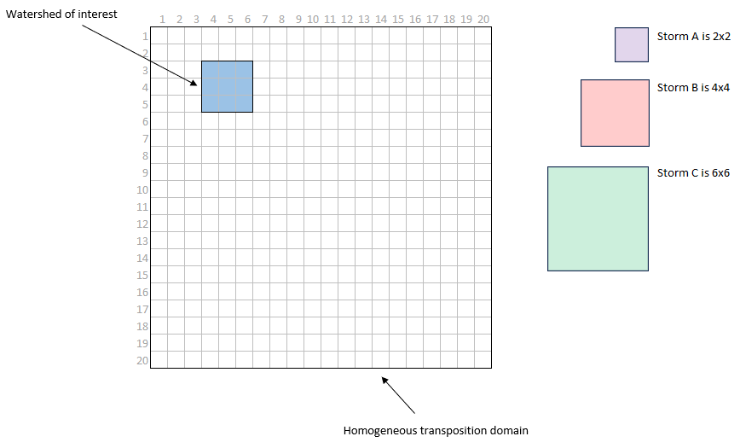
SST Toy Problem
Transposition domain is 20 x 20 grid cells
Watershed is 3 x 3 grid cells
Three storm templates of varying sizes to transpose within the domain

Slide 3
SST Toy Problem – Basic Monte Carlo
For i = 1 to 100,000
Sample storm shape (A, B, or C)
Sample centroid of storm (x, y) from uniform distributions
X ~ U(1, 20)
Y ~ U(1, 20)
If storm overlaps with watershed, sample storm depth from N(10, 2)

Slide 4
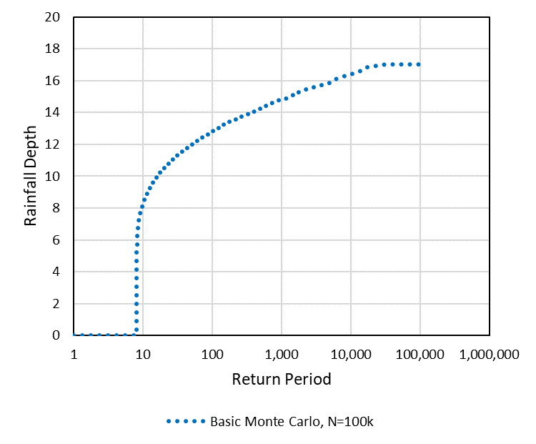
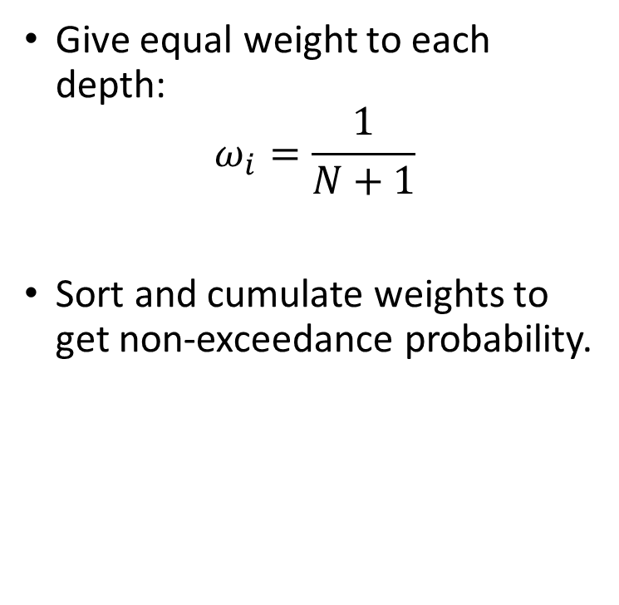
SST Toy Problem – Basic Monte Carlo
Give equal weight to each depth:
$$ω_{i}=\frac{1}{N+1}$$
Sort and cumulate weights to get non-exceedance probability.

Slide 5
SST Toy Problem – Importance Sampling
For i = 1 to 10,000
Sample storm shape (A, B, or C)
Sample centroid of storm (x, y) from truncated normal distributions
X ~ Trunc. N(5, 5.5, 1, 20)
Y ~ Trunc. N(4, 5.5, 1, 20)
If storm overlaps with watershed, sample storm depth from N(10, 2)

Slide 6
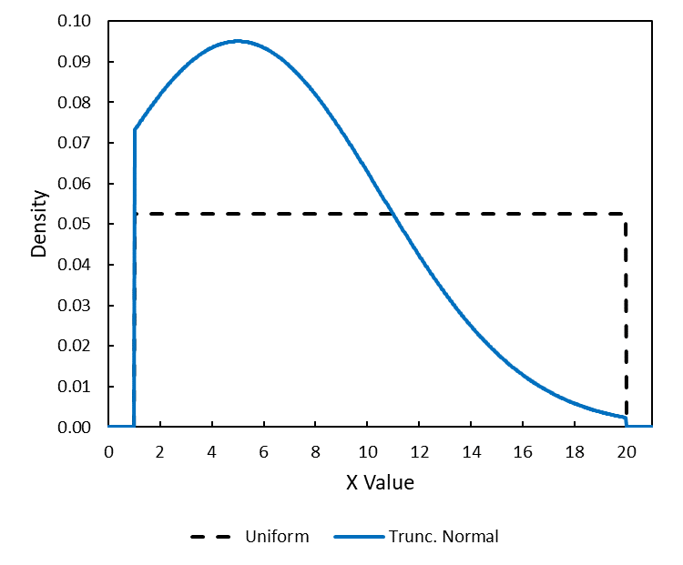
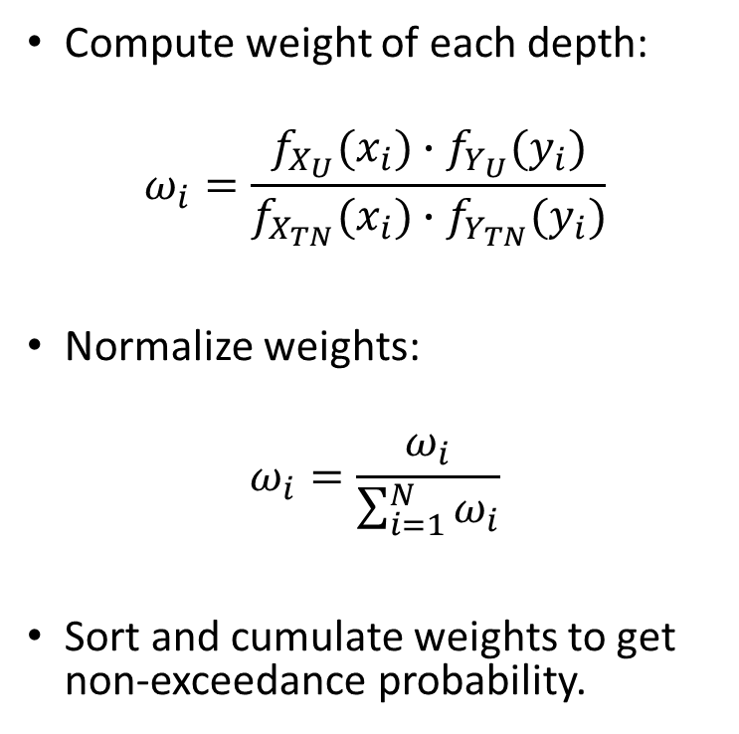
SST Toy Problem – Importance Sampling
Compute weight of each depth:
$$ω_{i}=\frac{f_{X_{U}}(x_{i})∙f_{Y_{U}}(y_{i})}{f_{X_{TN}}(x_{i})∙f_{Y_{TN}}(y_{i})}$$
Normalize weights:
$$ω_{i}=\frac{ω_{i}}{\sum_{i=1}^{N}{ω_{i}}}$$
Sort and cumulate weights to get non-exceedance probability.

Slide 7
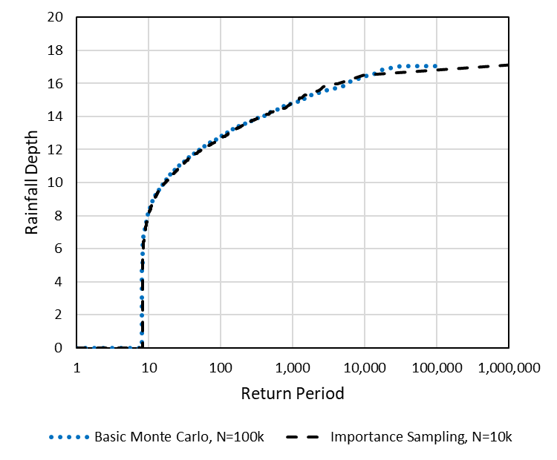
SST Toy Problem – Importance Sampling
Compute weight of each depth:
$$ω_{i}=\frac{f_{X_{U}}(x_{i})∙f_{Y_{U}}(y_{i})}{f_{X_{TN}}(x_{i})∙f_{Y_{TN}}(y_{i})}$$
Normalize weights:
$$ω_{i}=\frac{ω_{i}}{\sum_{i=1}^{N}{ω_{i}}}$$
Sort and cumulate weights to get non-exceedance probability.

Slide 8
Advanced Methods – Adaptive Sampling
Adaptive Stratified Sampling – Miser
Adaptive Importance Sampling – Vegas
Split Vegas:
“Vegas within Miser”

Slide 9
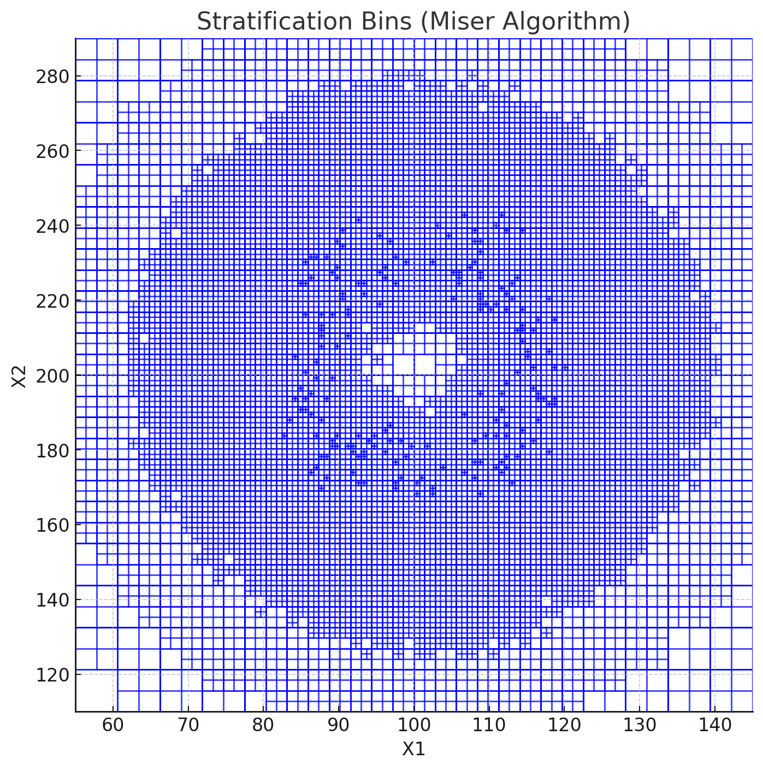
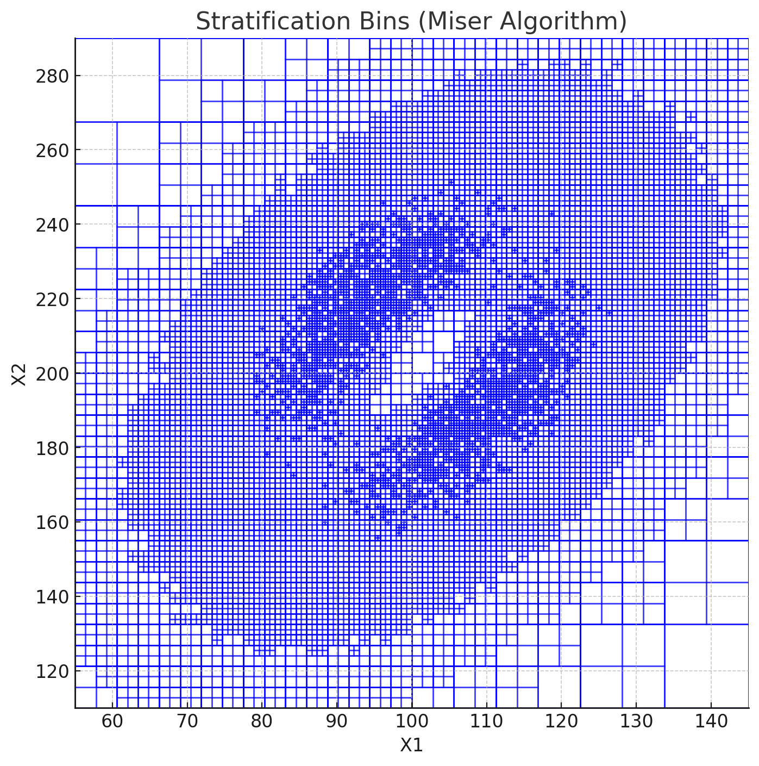
Adaptive Stratified Sampling - Miser

Slide 10
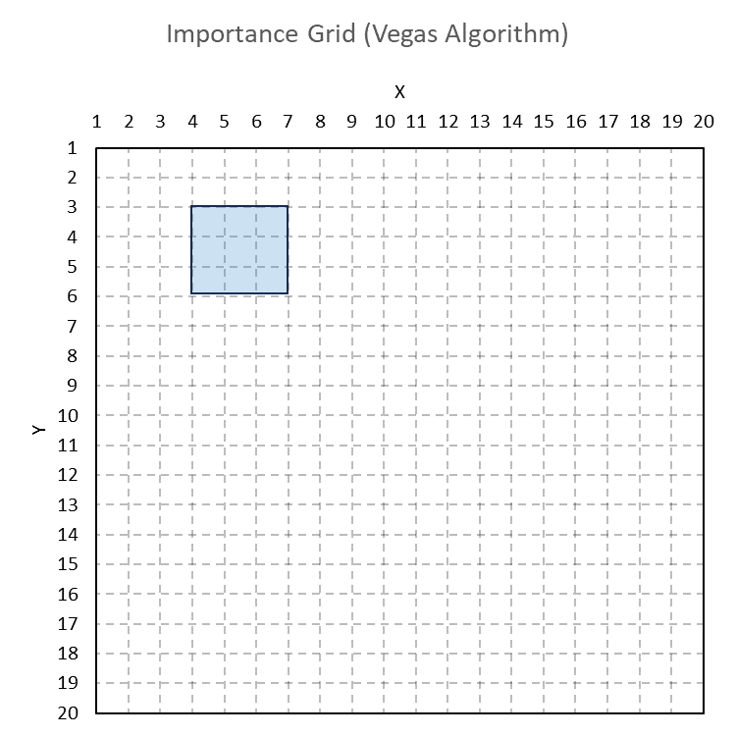
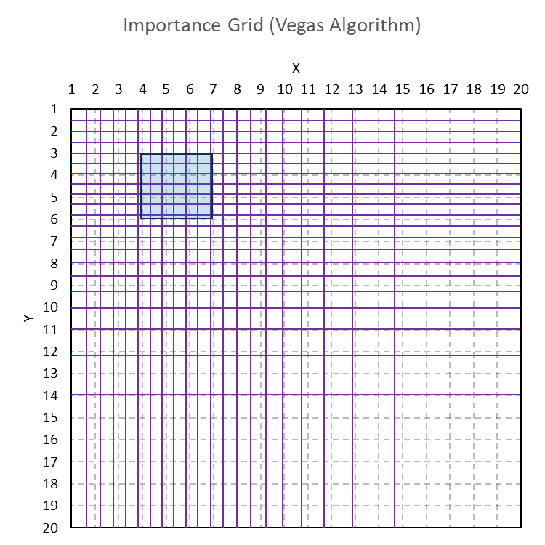
Adaptive Importance Sampling - Vegas

